Slide 1
Azure Workshop
Service Notes

Slide 2
App Service
Azure App Service enables you to build and host web apps, mobile back ends, and RESTful APIs in the programming language of your choice without managing infrastructure. It offers auto-scaling and high availability, supports both Windows and Linux, and enables automated deployments from GitHub, Azure DevOps, or any Git repo.
App Service Plan Options
- Windows
IIS
Application Runtime Stack (limited by OS type)
- Linux
Container
Application Runtime Stack (limited by OS type)
App Service Plan
Web App
Web App
Web App

Slide 3
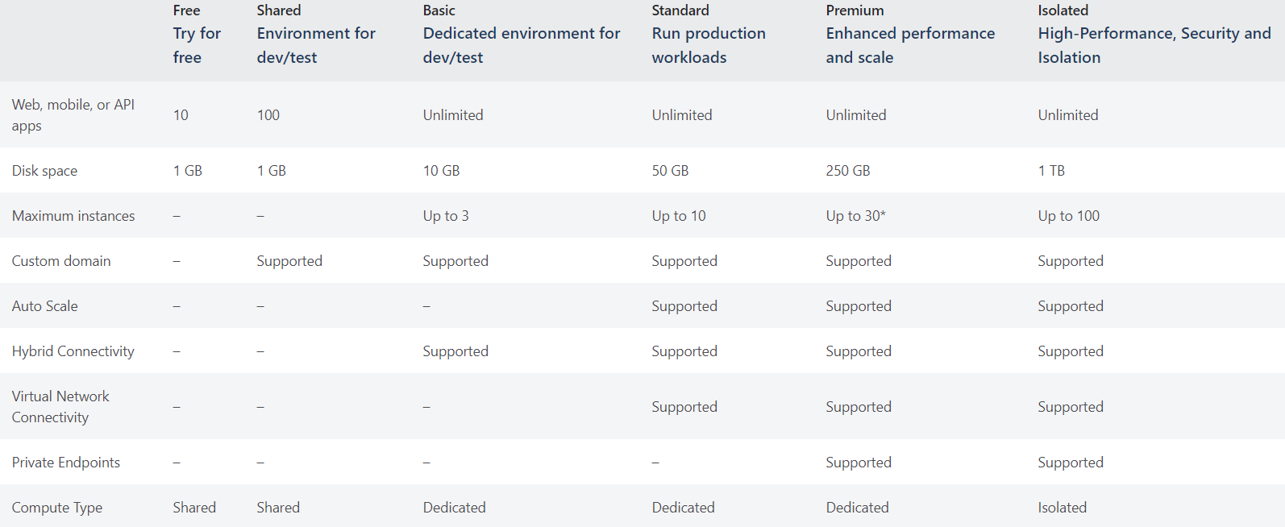
App Service Tiers

Slide 4
Deployment Options
Zip Package or FTP (**Not recommend)
Automated from Source Control (GIT Server)
Automated from DevOps Tools

Slide 5
Azure Active Directory
Azure Active Directory (Azure AD) is Microsoft’s cloud-based identity and access management service, which helps your employees sign in and access resources in:
External resources, such as Microsoft 365, the Azure portal, and thousands of other SaaS applications.
Internal resources, such as apps on your corporate network and intranet, along with any cloud apps developed by your own organization.

Slide 6
App Registration
The application object is the global representation of your application for use across all tenants
In order to delegate Identity and Access Management functions to Azure AD, an application must be registered with an Azure AD tenant. When you register your application with Azure AD, you are creating an identity configuration for your application that allows it to integrate with Azure AD.
If you register an application in the portal, an application object as well as a service principal object are automatically created in your home tenant. If you register/create an application using the Microsoft Graph APIs, creating the service principal object is a separate step.

Slide 7
Service Principal
A service principal is the local representation, or application instance, of a global application object in a single tenant or directory. A service principal is a concrete instance created from the application object and inherits certain properties from that application object. A service principal is created in each tenant where the application is used and references the globally unique app object. The service principal object defines what the app can actually do in the specific tenant, who can access the app, and what resources the app can access.

Slide 8
SQL Database
Azure SQL Database is a fully managed platform as a service (PaaS) database engine that handles most of the database management functions such as upgrading, patching, backups, and monitoring without user involvement.
Purchasing model
DTU-based | Vcore-based​
The DTU represents a blended measure of CPU, memory, reads, and writes. The main idea behind this model is its simplicity of using a preconfigured bundle of compute resources at a fixed cost with easy scalable options. | The vCore based model is new and it offers a totally different approach to sizing your database. It is easier to translate local workloads to a vCore based model because the components are what we are used too.

Slide 9
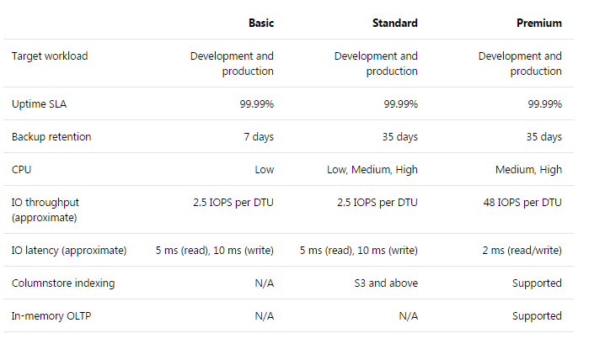
DTU-based
service tiers

Slide 10
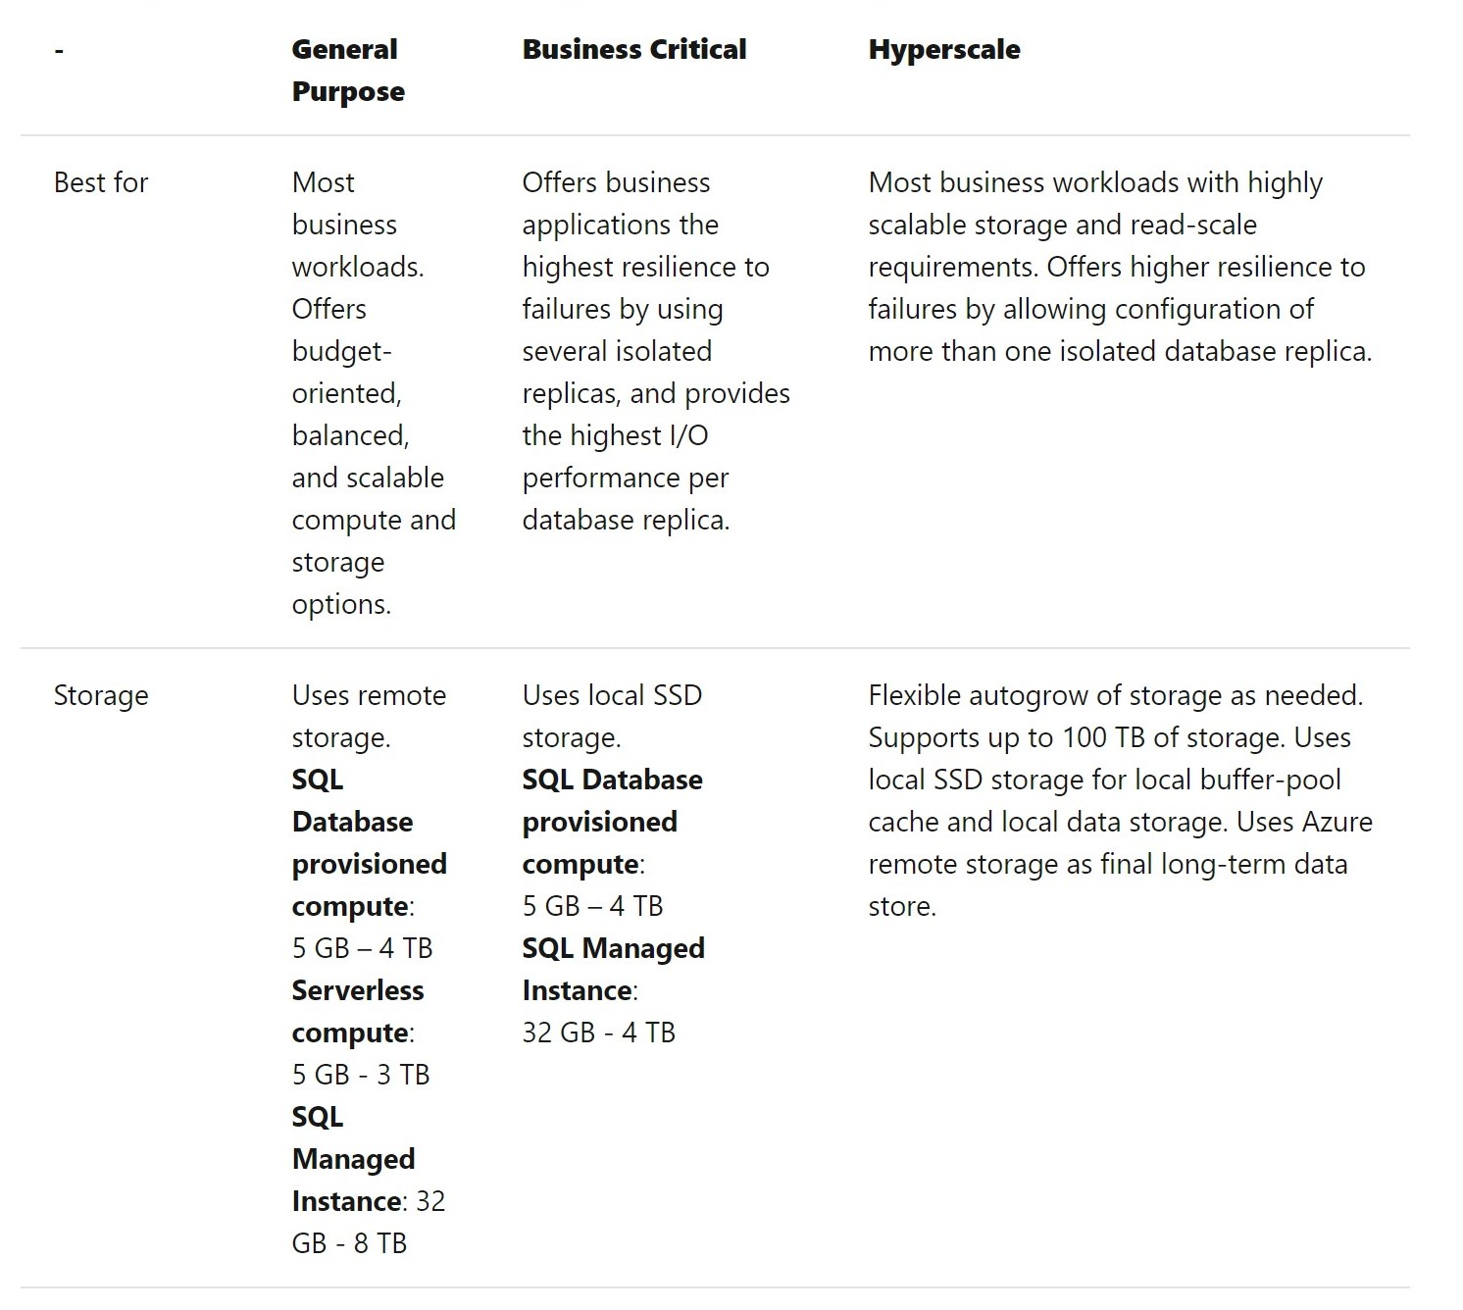

Vcore-based
service tiers

Slide 11
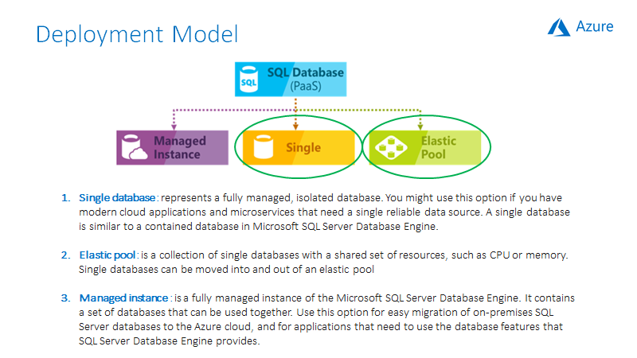

Slide 12
Connectivity Protection Options
1. Allow Azure Services
All Azure services (including other user’s resources) can reach the server.
2. Virtual Networks
Only specify virtual network can reach the server
3. Private Endpoints
Database gains private IP address within the Virtual Network. Force connect to the server using assigned private IP only

Slide 13
Azure Storage
The Azure Storage platform includes the following data services:
Azure Blobs: A massively scalable object store for text and binary data. Also includes support for big data analytics through Data Lake Storage Gen2.
Block Blob
Block blobs are optimized for uploading large amounts of data efficiently
Append Blob
An append blob is comprised of blocks and is optimized for append operations. When you modify an append blob, blocks are added to the end of the blob only
Azure Files: Managed file shares for cloud or on-premises deployments.
Azure Queues: A messaging store for reliable messaging between application components.
Azure Tables: A NoSQL store for schemaless storage of structured data.
Azure Disks: Block-level storage volumes for Azure VMs.

Slide 14
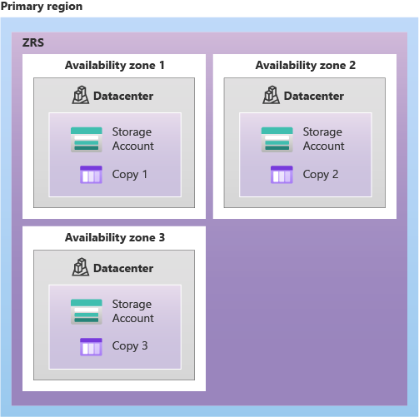
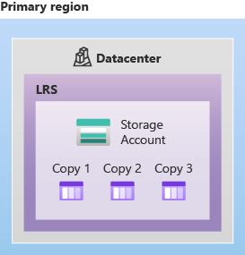
Storage Redundancy

Slide 15
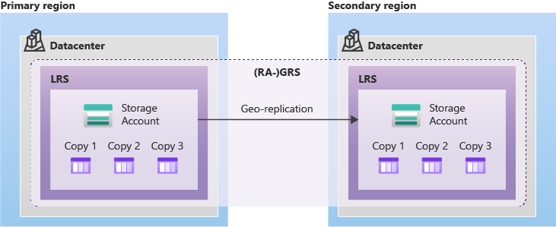
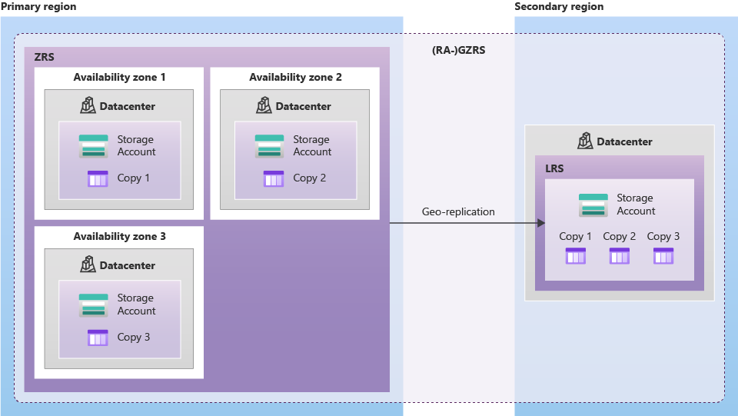
Storage Redundancy

Slide 16
Key Vault
Secrets Management - Azure Key Vault can be used to Securely store and tightly control access to tokens, passwords, certificates, API keys, and other secrets
Key Management - Azure Key Vault can also be used as a Key Management solution. Azure Key Vault makes it easy to create and control the encryption keys used to encrypt your data.
Certificate Management - Azure Key Vault is also a service that lets you easily provision, manage, and deploy public and private Transport Layer Security/Secure Sockets Layer (TLS/SSL) certificates for use with Azure and your internal connected resources.
Azure Key Vault has two service tiers: Standard, which encrypts with a software key, and a Premium tier, which includes hardware security module(HSM)-protected keys.
Azure Key Vault is designed so that Microsoft does not see or extract your data

Slide 17
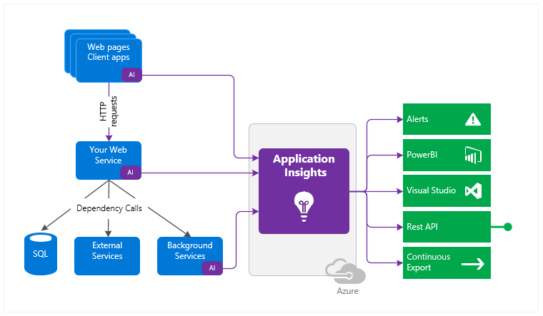
Application Insights
Application Insights is an extensible Application Performance Management (APM) service for developers and DevOps professionals. Use it to monitor your live applications. It will automatically detect performance anomalies, and includes powerful analytics tools to help you diagnose issues and to understand what users actually do with your app.

Slide 18
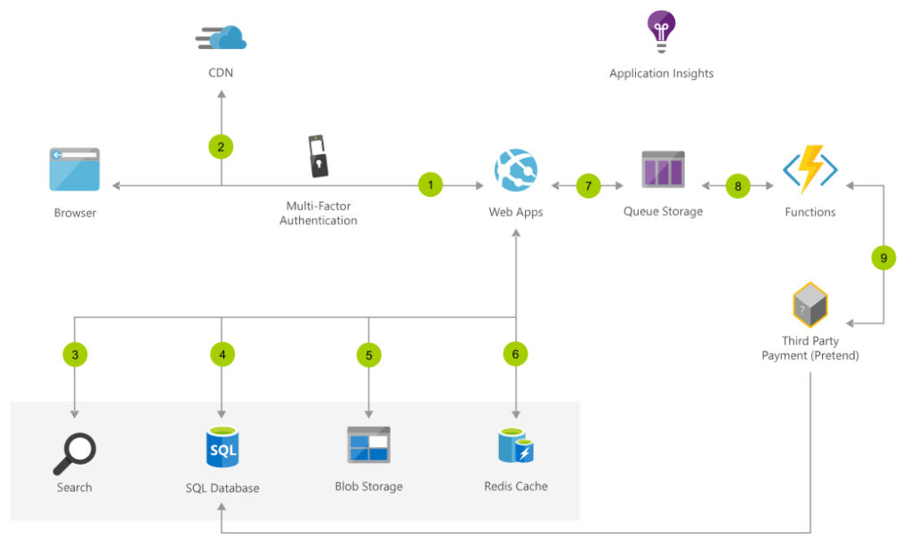
Azure Functions
Azure Functions provides "compute on-demand" in two significant ways.
First, Azure Functions allows you to implement your system's logic into readily available blocks of code. These code blocks are called "functions". Different functions can run anytime you need to respond to critical events.
Second, as requests increase, Azure Functions meets the demand with as many resources and function instances as necessary - but only while needed. As requests fall, any extra resources and application instances drop off automatically

Slide 19
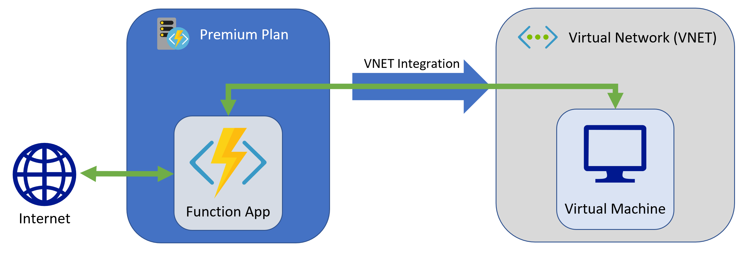
V-NET Integration

Slide 20
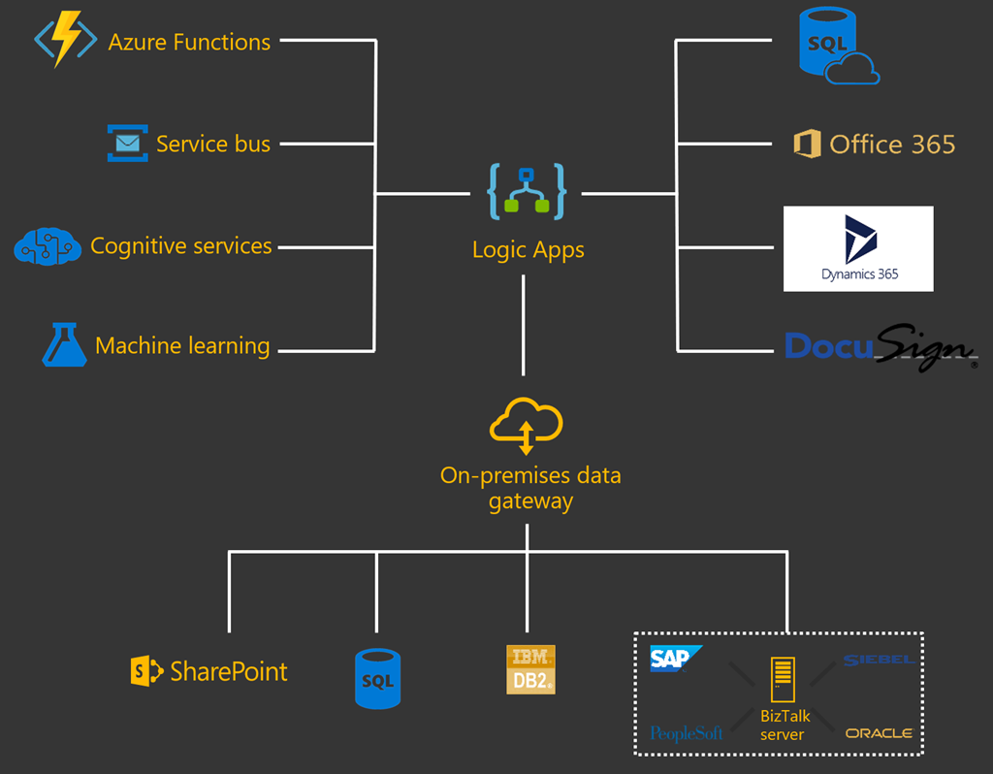
Logic Apps
Azure Logic Apps provides a serverless engine to build automated workflows to integrate apps and data between cloud services and on-premises systems. You build workflows using a visual designer. You can trigger workflows based on events or timers and leverage connectors to integration applications and facilitate business-to-business (B2B) communication.

Slide 21
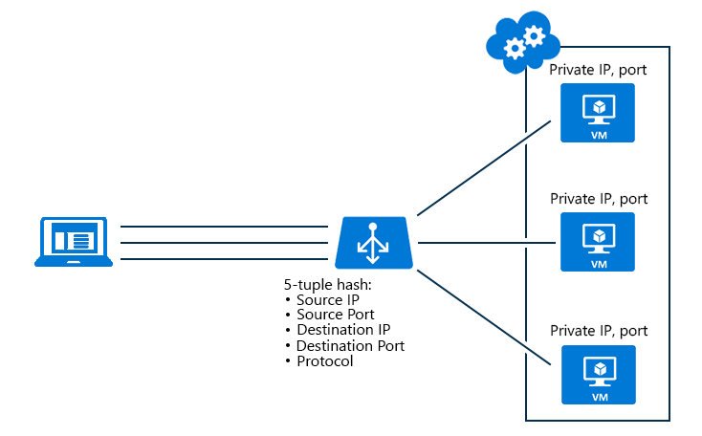
Azure Load balancer

Slide 22
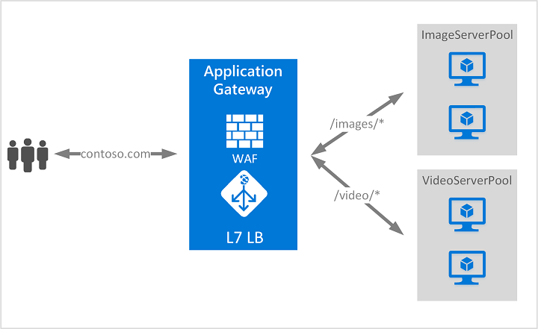
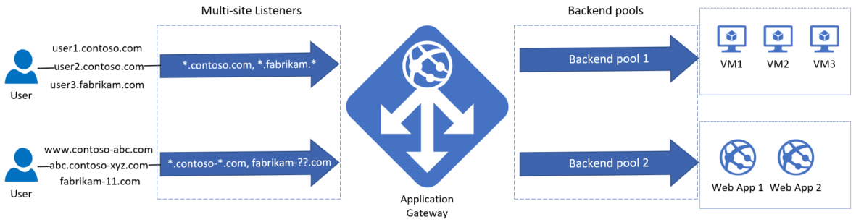
Application Gateway

Slide 23
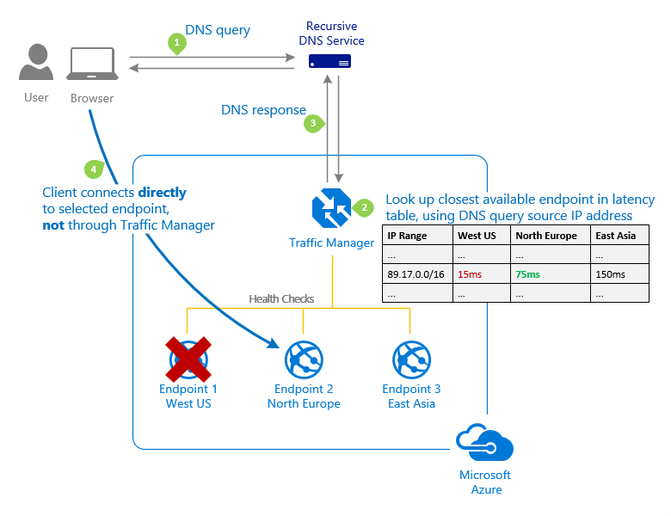
Traffic Manager

Slide 24
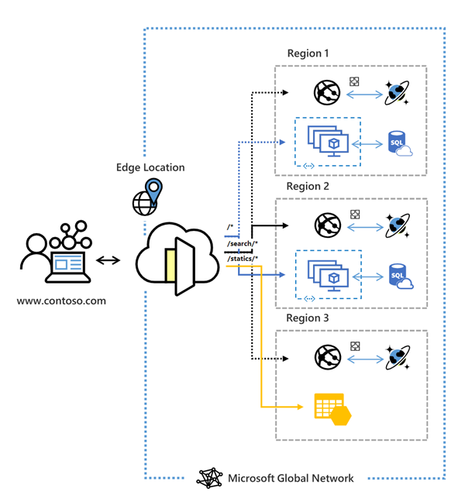
Azure Front Door
Front Door works at Layer 7 (HTTP/HTTPS layer) using anycast protocol with split TCP and Microsoft's global network to improve global connectivity. Based on your routing method you can ensure that Front Door will route your client requests to the fastest and most available application backend. An application backend is any Internet-facing service hosted inside or outside of Azure

